Slide 1
Introduction to Artificial Intelligence

Slide 2
Contents
Introduction to Artificial Intelligence
History
AI Programming Methods.
Applications
Top 10 Hot Artificial Intelligence (AI) Technologies

Slide 3
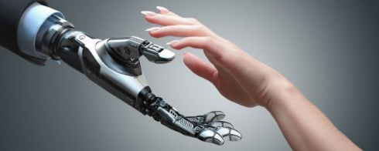
Intelligence vs Artificial Intelligence
Intelligence is a property/ability attributed to people, such as to know, to think, to talk, to learn, to understand.
Intelligence = Knowledge + ability to perceive, feel, comprehend, process, communicate, judge, learn.
Artificial Intelligence is an interdisciplinary field aiming at developing techniques and tools for solving problems that people are good at.

Slide 4
What’s involved in Intelligence?
Ability to interact with the world
Speech
Vision
Thinking
Decision making
Motion, etc.
Ability to learn and to adapt
Traditionally, AI is an effort to solve problems by applying knowledge and so we must answer these questions:
how do we represent knowledge
how do we apply that knowledge
often, the problems that we try to solve in AI require a lot of human knowledge – we may need access to human experts to acquire that knowledge and codify it.

Slide 5
Goals of Artificial Intelligence
Scientific goal: understand the mechanism behind human intelligence.
Engineering goal: develop concepts and tools for building intelligent agents capable of solving real world problems. Examples:
Knowledge-based systems: capture expert knowledge and apply them to solve problems
Common sense reasoning systems: capture and process knowledge that people commonly hold which is not explicitly communicated.
Learning systems: have the ability to expend their knowledge based on the accumulated experience.
Natural language understanding systems.
Intelligent robots.
Speech and vision recognition systems.
Game playing (IBM’s Deep Blue)

Slide 6
History of AI

Slide 7
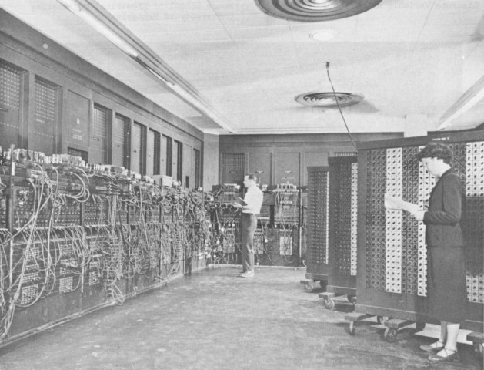
1941-First Electronic Computer
ENIAC - Electronic Numerical Integrator and Computer
Medium that made AI possible

Slide 8
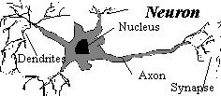
1943 – Neural Networks
McCulloch & Pitts proposed a model of artificial neurons in 1943
foundation: basic physiology of the brain
each neuron either 'on' or 'off'

Slide 9
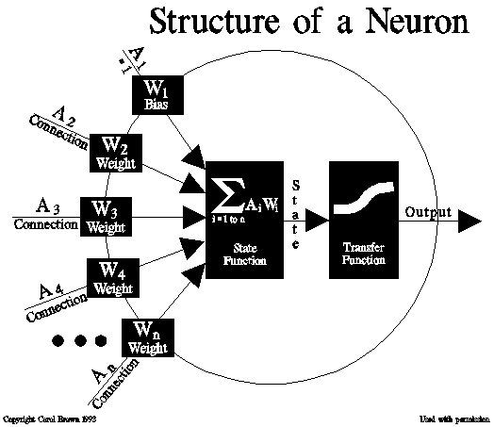
Neural Networks
Switch to 'on' (response) if sufficient number of neighbors are 'on' (stimulus)
Training - reading sample data and iteratively adjusting the network's weights to produce optimum predictions

Slide 10
Neural Networks
Results:
Any computable function was shown to be computable by some network of connected neurons
Suggested that suitably defined networks could learn

Slide 11
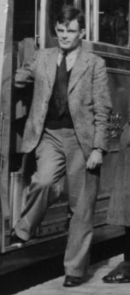

1950 – The Turing Test
Turing claimed that computers would in time acquire abilities equal to human intelligence.
As part of his argument Turing put forward the idea of an ‘imitation game’ (Turing Test)
An annual competition started by Dr. Hugh Gene Loebner in 1991- a $100,000 prize is offered to the author of the first computer program to pass an unrestricted Turing test.

Slide 12
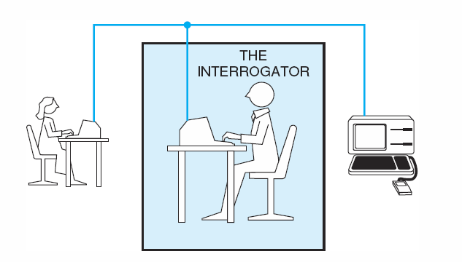
Turing Test
An interrogator poses questions to two entities, a human and a computer
If the interrogator cannot tell which is the human and which is the computer, then the computer passes the Turing Test and should be considered intelligent

Slide 13
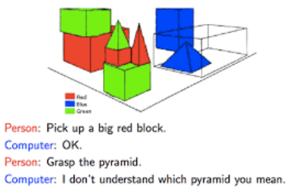
1960’s – AI Programs
Weizenbaum’s ELIZA. –NLP Tool
Colby’s PARRY. –Chatbot
Winograd’s SHRDLU –NLP Tool by MIT

Slide 14

1963 – DARPA Grant
In 1963 MIT received a 2.2 million dollar grant from the United States government to be used in researching Machine-Aided Cognition (artificial intelligence).
Served to increase the pace of development in AI research

Slide 15
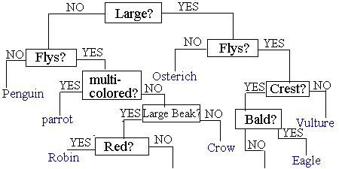
1970's - Expert Systems
Example: A program to distinguish birds
Predicts the probability of a solution using a database of knowledge
Newer expert systems use fuzzy logic

Slide 16
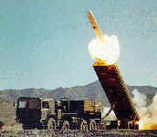
AI Being Incorporated in War (early 1990's)
The Persian Gulf War proved the importance of AI research for military use.
Cruise missiles were equipped with AI-related technologies such as Robotics and Machine Vision.

Slide 17
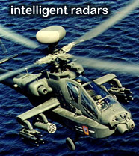
AI In The Military – 1990’s
Determine whether the threat detected is in fact a threat
Advanced autopilot
Greatly decrease peacetime and wartime accidents

Slide 18
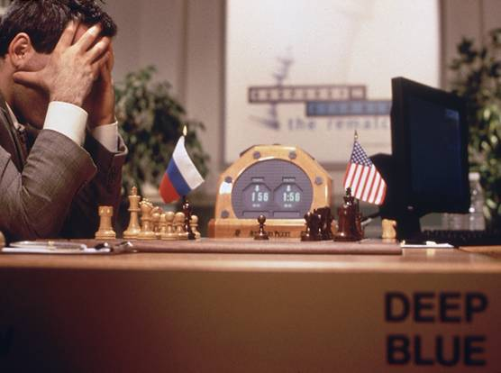
1997 – Deep Blue Defeats Kasparov
The IBM computer named Deep Blue was capable of processing 200 million chess positions per second
Garry Kasparov - world chess champion, was defeated in the series 3.5 games to 2.5 games

Slide 19
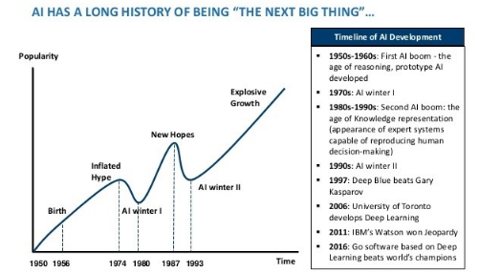
AI Winters

Slide 20
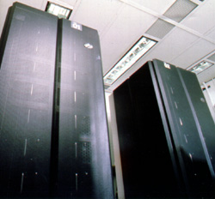
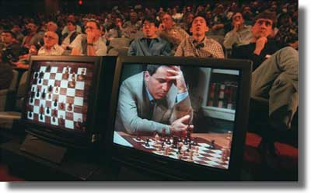
Chess
In 1997, Deep Blue beat Gary Kasparov.
Notes:
Is this AI? Is it just search? Is chess a representative “intelligent problem”?
What about role playing games? Need a lot more knowledge.

Slide 21
AI Programming Methods

Slide 22
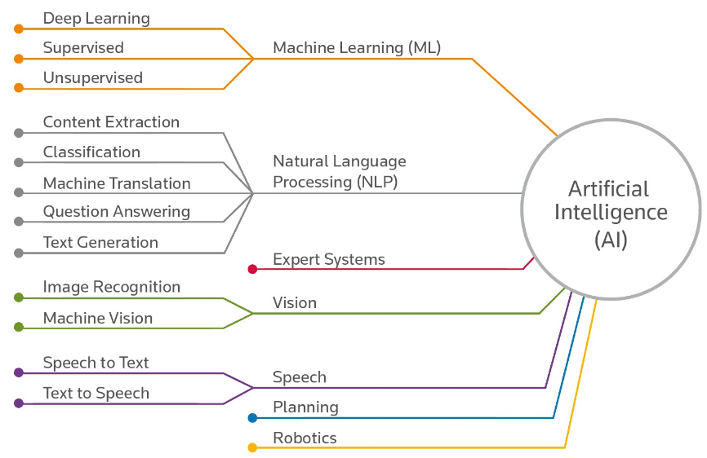
Artificial Intelligence Streams

Slide 23
Statistical Methods
Inferential Statistics: Probability Distribution Functions, Random Variables, Sampling Methods
Hypothesis Testing: Formulate and test hypotheses to solve business problems
Exploratory Data Analysis:Summarize data sets and derive initial insights

Slide 24
Machine Learning
Linear Regression: Implement linear regression and predict continuous data values
Supervised Learning: Implement algorithms like Naive Bayes, KNN, SVM, Logistic Regression, etc.
Unsupervised Learning: Create segments based on similarities using K-Means and Hierarchical clustering

Slide 25
Deep Learning
Information flow in a neural network: Understand the components and structure of artificial neural networks
Training a neural network: Learn the cutting-edge techniques used to train highly complex neural networks
Convolutional Neural Networks: Use CNN's to solve complex image classification problems
Recurrent Neural Networks: RNN's applications in text analytic
Creating and deploying networks using Tensorflow and keras: Build and deploy your own deep neural, learn to use the Tensorflow API and Keras

Slide 26
Natural Language processing
Basics of text processing: Get started with the Natural language toolkit, learn the basics of text processing in python
Lexical processing: Learn how to extract features from unstructured text and build machine learning models on text data
Syntax and Semantics: Conduct sentiment analysis, learn to parse English sentences and extract meaning from them
Other problems in text analytics: Explore the applications of text analytics in new areas and various business domains

Slide 27
Reinforcement Learning
Reinforcement learning (RL) is an area of machine learning concerned with how software agents ought to take actions in an environment so as to maximize some notion of cumulative reward.

Slide 28
AI Applications

Slide 29
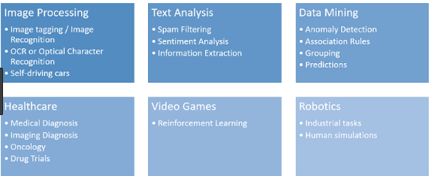
AI Applications

Slide 30
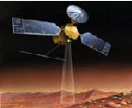
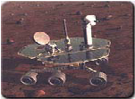
AI Applications
Autonomous Planning & Scheduling:
Autonomous rovers.

Slide 31
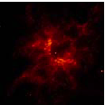


AI Applications
Autonomous Planning & Scheduling:
Analysis of data:

Slide 32

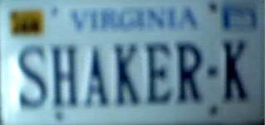
AI Applications
Medicine:
Image analysis and enhancement

Slide 33

AI Applications
Transportation:
Autonomous vehicle control:

Slide 34

AI Applications
Transportation:
Pedestrian detection:

Slide 35
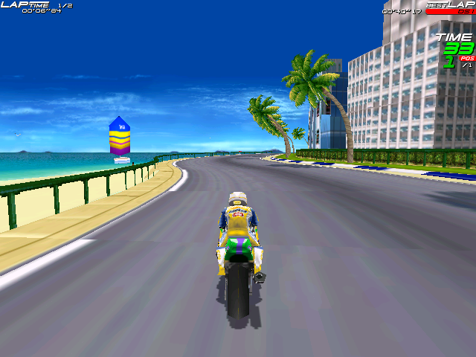
AI Applications
Games:

Slide 36
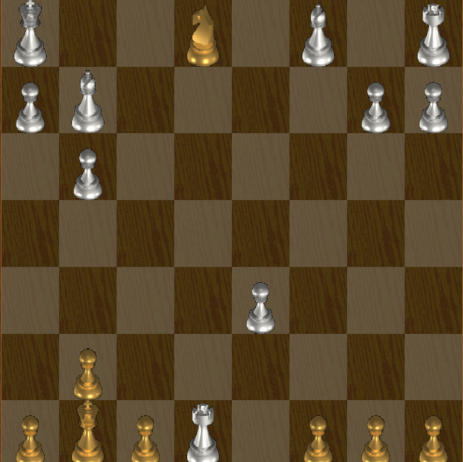
AI Applications
Games:

Slide 37
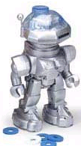

AI Applications
Robotic toys:

Slide 38
Top 10 Hot Artificial Intelligence (AI) Technologies Today
Natural Language Generation: Producing text from computer data. Currently used in customer service, report generation, and summarizing business intelligence insights. Sample vendors: Attivio, Automated Insights, Cambridge Semantics, Digital Reasoning, Lucidworks, Narrative Science, SAS, Yseop.
Speech Recognition: Transcribe and transform human speech into format useful for computer applications. Currently used in interactive voice response systems and mobile applications. Sample vendors: NICE, Nuance Communications, OpenText, Verint Systems.

Slide 39
Virtual Agents chatbots like Alexa to advanced systems that can network with humans. Currently used in customer service and support and as a smart home manager. Sample vendors: Amazon, Apple, Artificial Solutions, Assist AI, Creative Virtual, Google, IBM, IPsoft, Microsoft, Satisfi.
Machine Learning Platforms: Providing algorithms, APIs, development and training toolkits, data, as well as computing power to design, train, and deploy models into applications, processes, and other machines. Currently used in a wide range of enterprise applications, mostly `involving prediction or classification. Sample vendors: Amazon, Fractal Analytics, Google, H2O.ai, Microsoft, SAS, Skytree

Slide 40
AI-optimized Hardware: Graphics processing units (GPU) and appliances specifically designed and architected to efficiently run AI-oriented computational jobs. Currently primarily making a difference in deep learning applications. Sample vendors: Alluviate, Cray, Google, IBM, Intel, Nvidia.
Decision Management: Engines that insert rules and logic into AI systems and used for initial setup/training and ongoing maintenance and tuning. A mature technology, it is used in a wide variety of enterprise applications, assisting in or performing automated decision-making. Sample vendors: Advanced Systems Concepts, Informatica, Maana, Pegasystems, UiPath.

Slide 41
Deep Learning Platforms: A special type of machine learning consisting of artificial neural networks with multiple abstraction layers. Currently primarily used in pattern recognition and classification applications supported by very large data sets. Sample vendors: Deep Instinct, Ersatz Labs, Fluid AI, MathWorks, Peltarion, Saffron Technology, Sentient Technologies.
Biometrics: Enable more natural interactions between humans and machines, including but not limited to image and touch recognition, speech, and body language. Currently used primarily in market research. Sample vendors: 3VR, Affectiva, Agnitio, FaceFirst, Sensory, Synqera, Tahzoo.

Slide 42
Robotic Process Automation: Using scripts and other methods to automate human action to support efficient business processes. Currently used where it’s too expensive or inefficient for humans to execute a task or a process. Sample vendors: Advanced Systems Concepts, Automation Anywhere, Blue Prism, UiPath, WorkFusion.
Text Analytics and NLP: Natural language processing (NLP) uses and supports text analytics by facilitating the understanding of sentence structure and meaning, sentiment, and intent through statistical and machine learning methods. Currently used in fraud detection and security, a wide range of automated assistants, and applications for mining unstructured data. Sample vendors: Basis Technology, Coveo, Expert System, Indico, Knime, Lexalytics, Linguamatics, Mindbreeze, Sinequa, Stratifyd, Synapsify.

Slide 43
Thank You

